Slide 1
Communications toolkit for primary and secondary school children
Flu vaccinations

Slide 2
Flu Vaccinations
This mini-campaign toolkit is available for primary and secondary schools to use and adapt to encourage the uptake of the flu vaccination for children from reception to year 11.
On behalf of the NHS across Dudley, Sandwell, Walsall and Wolverhampton we would really appreciate your support to raise awareness with parents of the importance of their child or children getting the flu vaccine this year.
There are links to posters and leaflets (in several languages including a British Sign Language video), which you can share with parents, and content that you can also use on your website, in parent newsletters, on your social media channels or in any other communication channels you have.
As you may be aware, the nasal spray vaccine is free for children aged 2-3 years, those in primary and secondary schools up to year 11. It is also free for children and young people who have a medical condition from the age of six months.
There is more information online, go to Vaccinations - child flu vaccine - nhs.uk
Read more about flu vaccinations in school, go to Flu vaccination in schools - GOV.UK (www.gov.uk)

Slide 3
Case Studies
We're always keen to share stories about children getting their flu vaccination and why it's important to help encourage uptake amongst other children. If you know of any families at your school that would be willing to feature as a case study on NHS websites and social media, please contact our communications team comms.blackcountry@nhs.net

Slide 4
Content to use

Slide 5
Case to use for parents
This winter you can protect your child and others from flu by making sure they get their flu vaccine.
The nasal spray vaccine is free for children aged 2-3 years, those in primary and in secondary schools up to year 11. The vaccine is also free for children and young people who have a medical condition from the age of six months.
Flu can be a very nasty illness in children, causing a range of symptoms including fever, dry cough, sore throat, aching joints, and extreme tiredness. The virus also spreads easily and children can pass it on to others.
The flu vaccination for children is needle-free for those aged 2-17 years. The nasal spray is given as a single squirt up each nostril; it’s quick, painless and more effective in children than an injectable vaccine.
Parents and guardians need to submit their consent for their child or children to have the nasal spray flu vaccine at school. If a child is home-schooled or not in mainstream education, they will be invited by the local school-aged immunisation service.

Slide 6
Key messages

Slide 7
Key messages for children's vaccines
Flu is an unpredictable virus that can kill thousands of people during a flu season. The flu vaccine is the best defence we have against it. Vaccination of children is based on the recommendation of the JCVI, the independent expert advisory group that advises government on vaccination.
The benefits include protection against flu for the children who receive the vaccine and reduced transmission of flu in the community. This is because children play a key role in spreading flu, including to those who may be at higher risk from the complications from flu such as the elderly.
Since the start of the programme, research has shown that vaccinating large numbers of children has reduced the circulation of flu in the community. Having the flu vaccination and staying well means children are able to continue going to nursery and school, socialising with their friends and participating in usual activity.

Slide 8
Key messages for parents
The flu vaccine for children is a quick and painless nasal spray, not an injection. It’s their best protection and prevents the spread of the virus.
Having the vaccine will help protect your child from what can be a very nasty illness in children. Children under the age of 5 years have the highest rate of hospital admissions due to flu.
It will reduce the chance of others in your family, who could be at greater risk from flu, such as grandparents or those with long-term health conditions, getting flu from your child.
It will help to reduce flu levels in the population in the winter when there may be pressure on the NHS with coronavirus (COVID-19) and other respiratory viruses in circulation.
It is also important because many people at risk from flu are also vulnerable to the complications of coronavirus (COVID-19) and research shows that if you get both flu and COVID-19 at the same time you may be more seriously ill.
It can help you avoid having to take time off work or other activities because you are ill or need to look after your sick child.
Submit your consent for your child or children to have the nasal spray flu vaccine at school. If your child is home-schooled or not in mainstream education, they will be invited by the local school-aged immunisation service.

Slide 9
Injectable alternative for children – flu vaccine
The nasal flu vaccine is offered to children as it is more effective in the programme than the injected vaccine. This is because it is easier to administer and considered better at reducing the spread of flu to others, who may be more vulnerable to the complications of flu.
However, if your child is at high risk from flu due to one or more medical conditions or treatments and can’t have the nasal flu vaccine they should have the flu vaccine by injection.
For those who may not accept the use of porcine gelatine in medical products, an alternative injectable vaccine is available this year.
You should discuss your options with your GP practice or School Nurse.

Slide 10
Resources

Slide 11
Newsletter copy
Protect your child against flu – five reasons for your child to have the flu vaccine
1. Protect your child – the vaccine will help protect your child against flu and serious complications such as bronchitis and pneumonia.
2. Protect you, your family and friends – vaccinating your child will help protect more vulnerable friends and family.
3. No injection needed – the nasal spray is painless and easy to have.
4. It’s better than having flu – the nasal spray helps protect against flu, has been given to millions of children worldwide and has an excellent safety record.
5. Avoid costs – if your child gets flu, you may have to take time off work or arrange alternative childcare.
Please submit your consent for your child to have the nasal spray flu vaccine at school, or if they are home schooled, accept the invite from the local school-aged immunisation service to have the vaccine at a local community clinic.

Slide 12
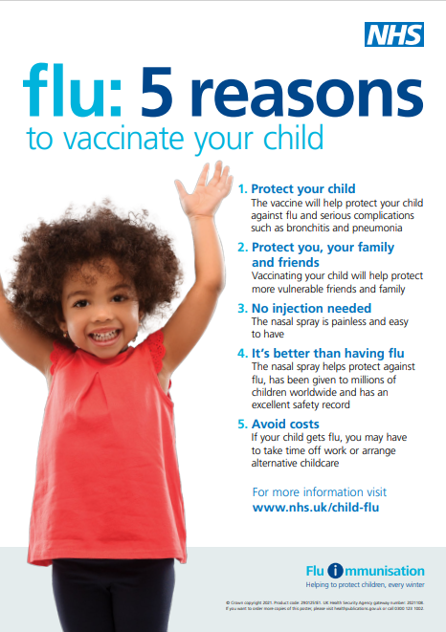
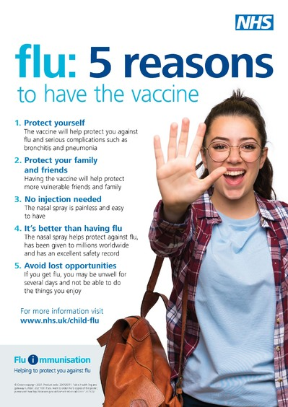
Newsletter images

Slide 13
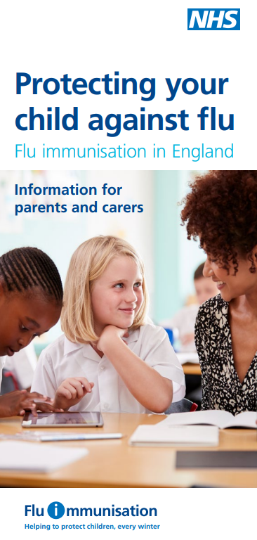
Leaflet: Information for parents and carers
Protecting your child against flu; Information for parents and carers (publishing.service.gov.uk) (English)
The leaflet is also available in:
Different languages: Albanian, Arabic, Bengali, Bulgarian, Chinese (simplified), Chinese (traditional, Cantonese), Estonian, Farsi, French, Greek, Gujarati, Hindi, Latvian, Lithuanian, Panjabi, Pashto, Polish, Portuguese, Romanian, Romany, Russian, Somali, Spanish, Tagalog, Turkish, Twi, Ukrainian, Urdu and Yiddish.
An English large print version is available to order.
A Braille version of this leaflet is available to order.
An audio version is available to download.

Slide 14
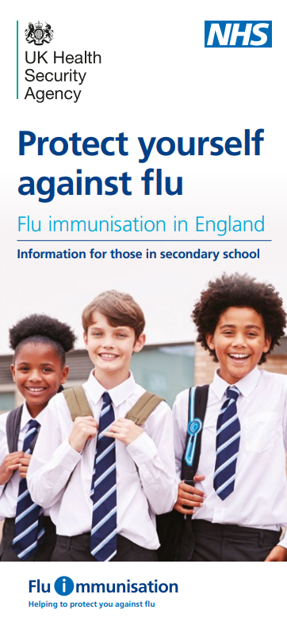
Leaflet: Protect yourself against flu (Secondary schools)
Protect yourself against flu; Information for those in secondary school (publishing.service.gov.uk) (English)
The leaflet is also available in:
Different languages: Albanian, Arabic, Bengali, Bulgarian, Chinese (simplified), Chinese (traditional, Cantonese), Estonian, Farsi, French, Greek, Gujarati, Hindi, Italian, Latvian, Lithuanian, Panjabi, Pashto, Polish, Portuguese, Romanian, Romany, Russian, Somali, Spanish, Tagalog, Tigrinya, Turkish, Twi, Ukrainian, Urdu, Yiddish and Yoruba.
A Braille version of this leaflet is available to order.
An audio version is available to download.

Slide 15
Poster: Primary school aged children
5 reasons to vaccinate your child against flu poster for primary schools and pre-schools
This poster is available free to order in the following languages:
English, Albanian, Arabic, Bengali, Brazilian Portuguese, Bulgarian, Chinese, Estonian, Farsi, Greek, Gujarati,
Hindi, Latvian, Lithuanian, Panjabi, Polish, Romanian, Romany,
Russian, Somali, Spanish, Turkish, Twi, Ukrainian, Urdu and Yiddish.

Slide 16
Poster: Secondary school aged children
5 reasons to vaccinate your child against flu poster for secondary schools
This poster is available free to order in the following languages:
English, Albanian, Arabic, Bengali, Brazilian Portuguese, Bulgarian, Chinese, Estonian, Farsi, Greek,
Gujarati, Hindi, Latvian, Lithuanian, Panjabi, Polish, Romanian,
Romany, Russian, Somali, Spanish, Turkish, Twi, Ukrainian, Urdu and Yiddish.

Slide 17

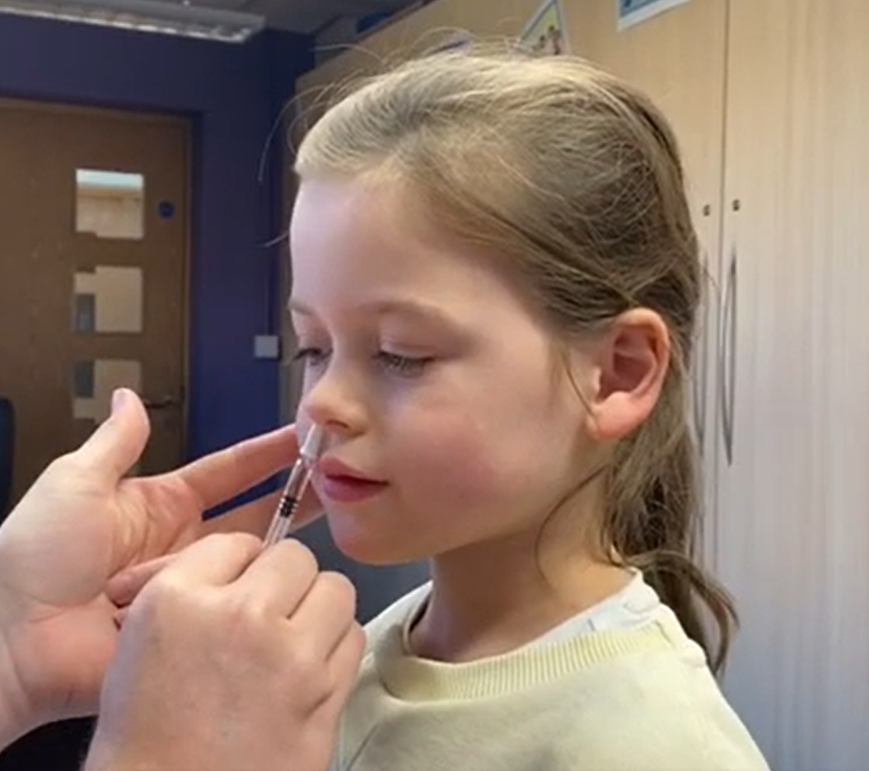
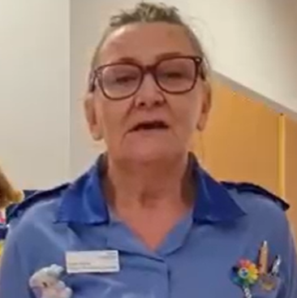
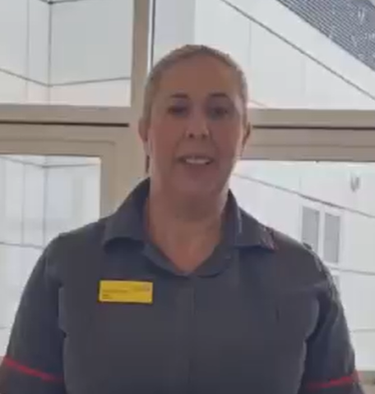
A British Sign Language video of ‘Protect yourself against flu; Information for those in secondary school’ leaflet is available to download
NHS England — North West » Injectable alternative for children – flu vaccine available to download
Dr Tania Hussain, a local GP in the Black Country, talks about the importance of the nasal spray flu vaccine for children in this short video.
Local community paediatric nurse tells us how the flu vaccine reduces your child's chance of needing hospital care for flu.
A matron on a local maternity ward describes how the flu vaccine can protect you and baby from serious illness.
Watch Sophie getting the nasal spray flu vaccine.

Slide 18

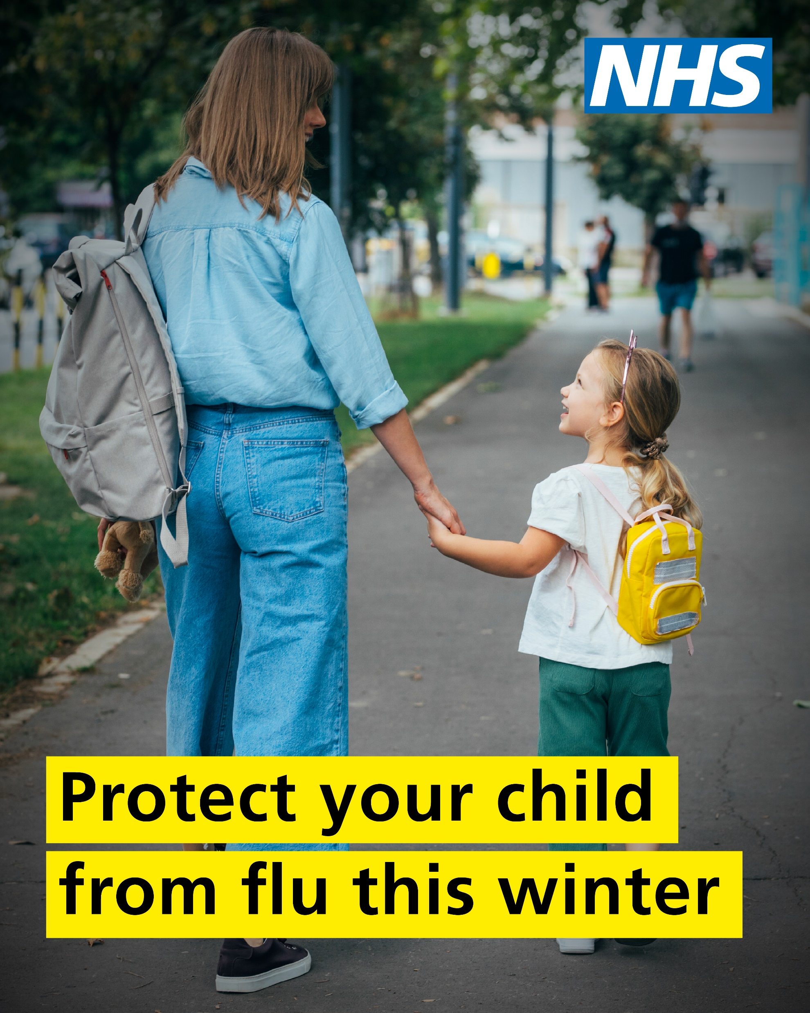
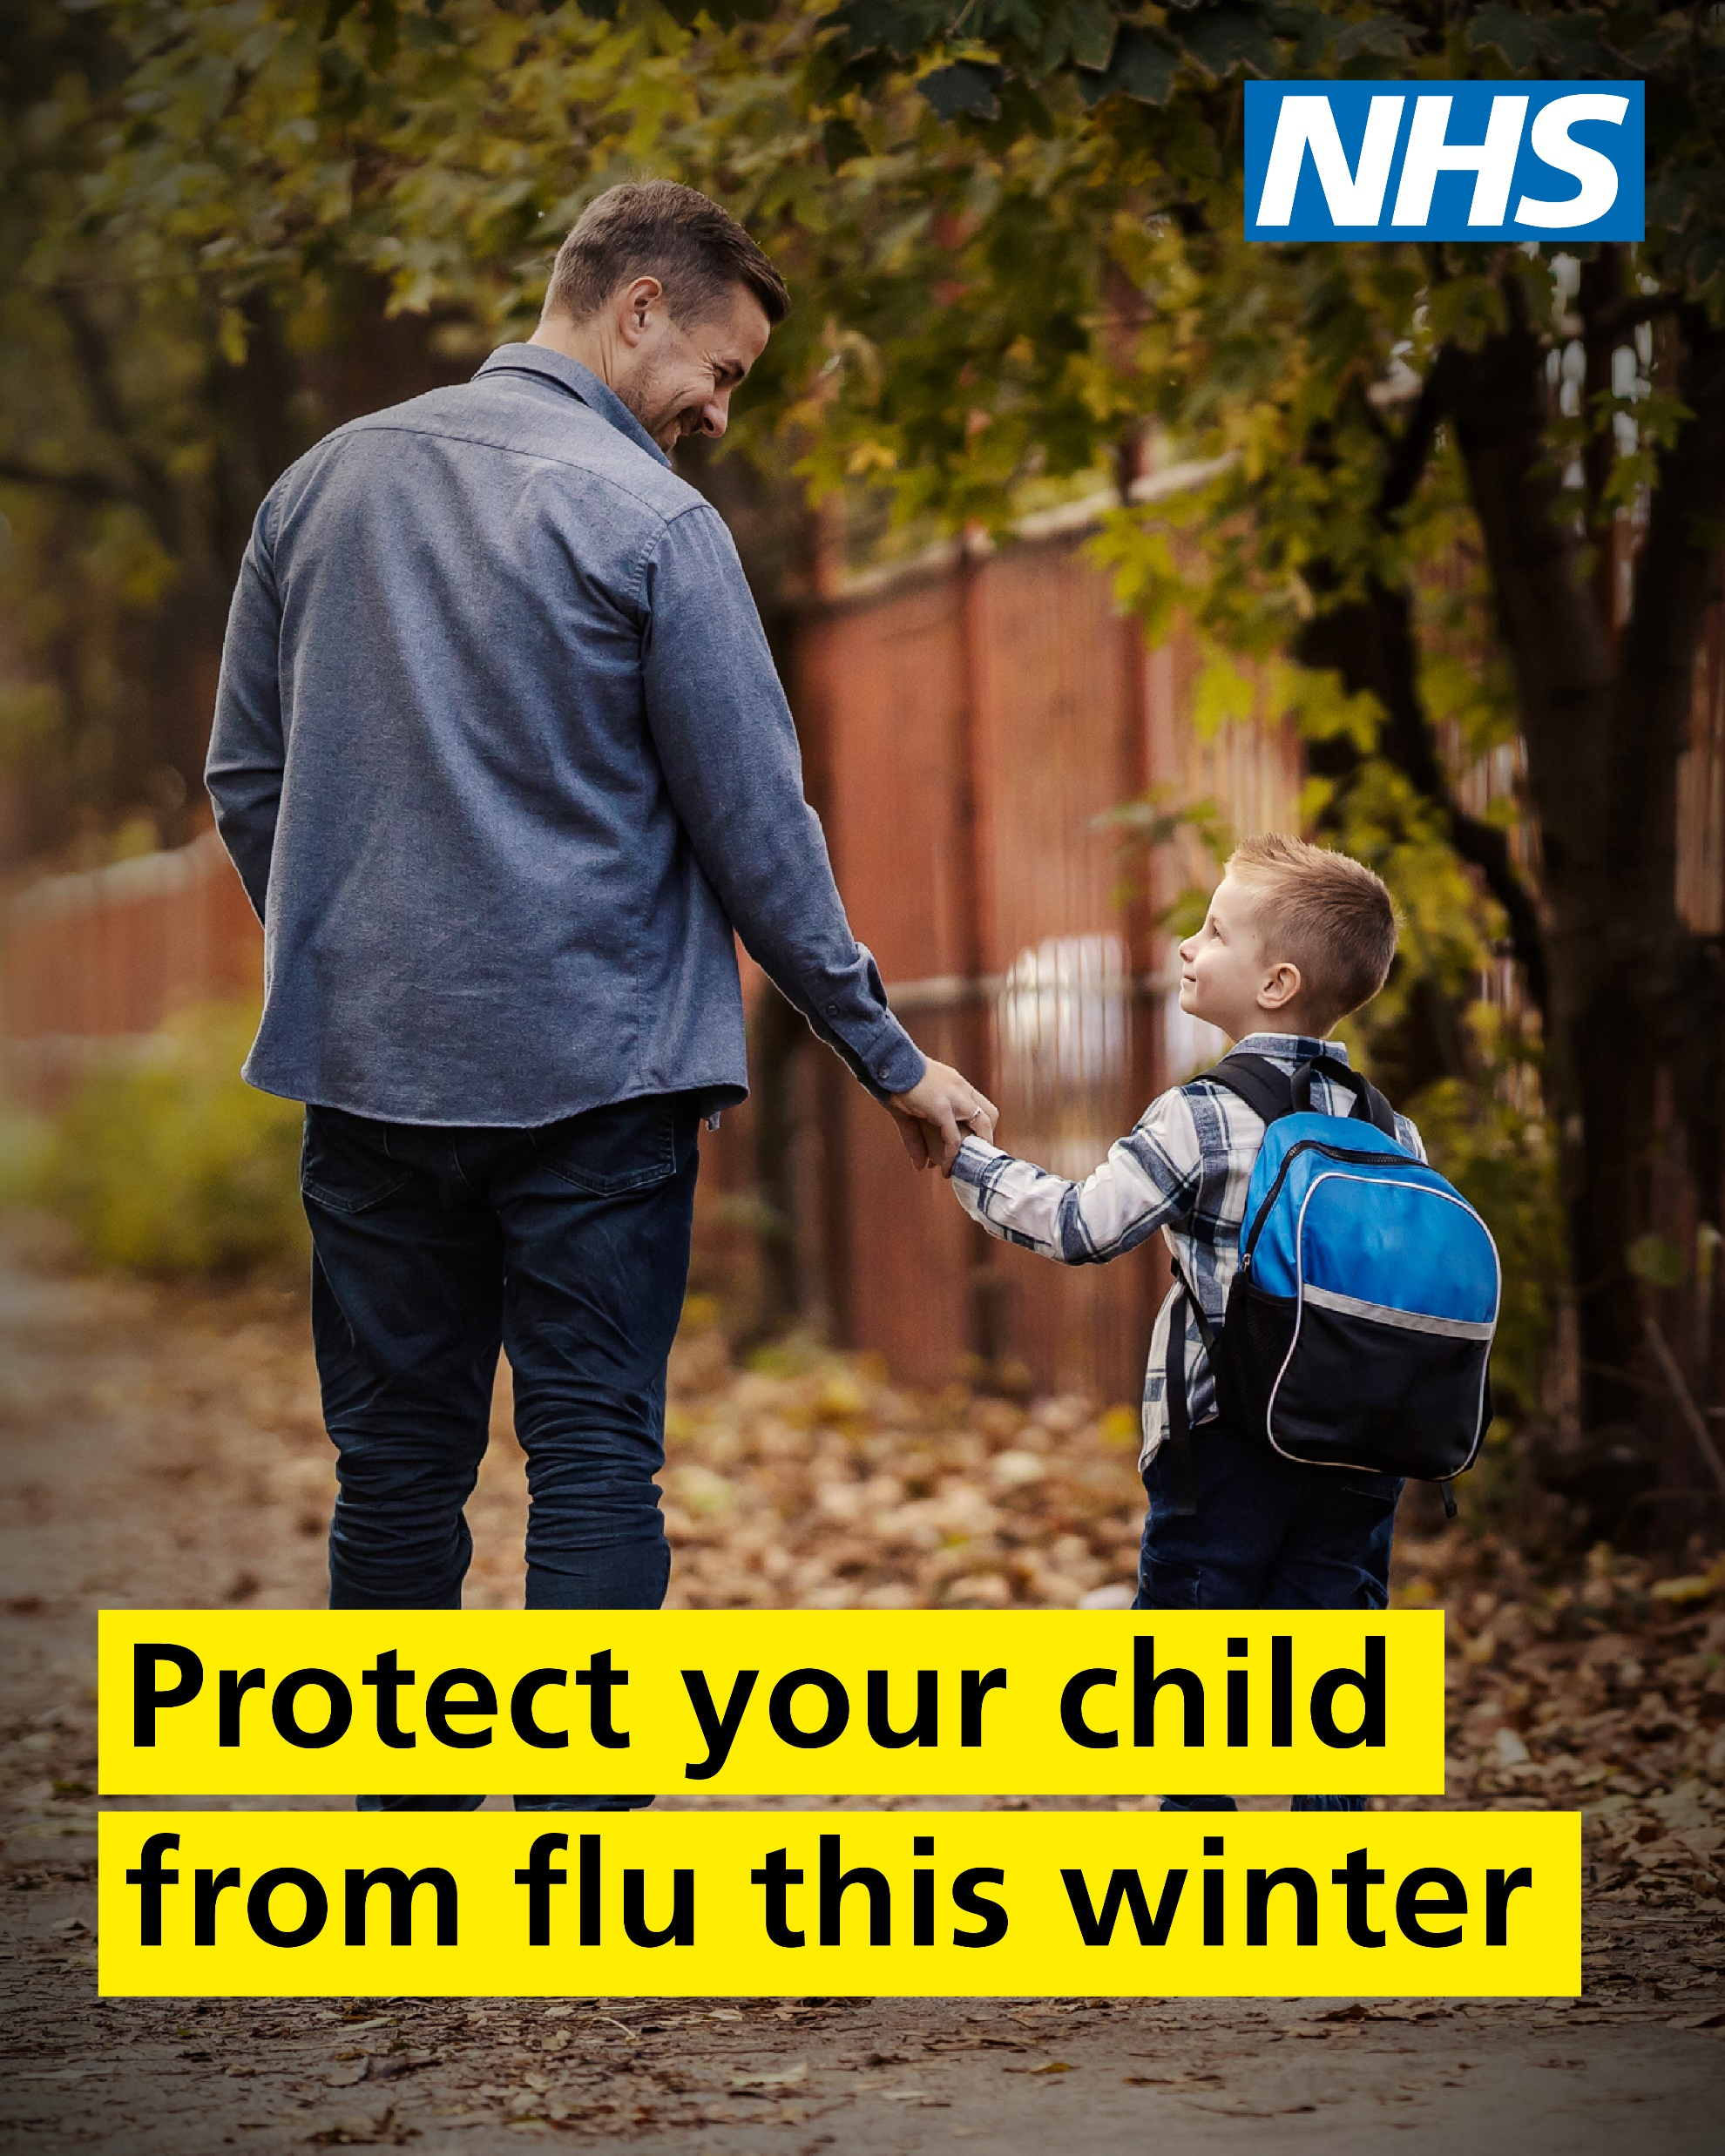
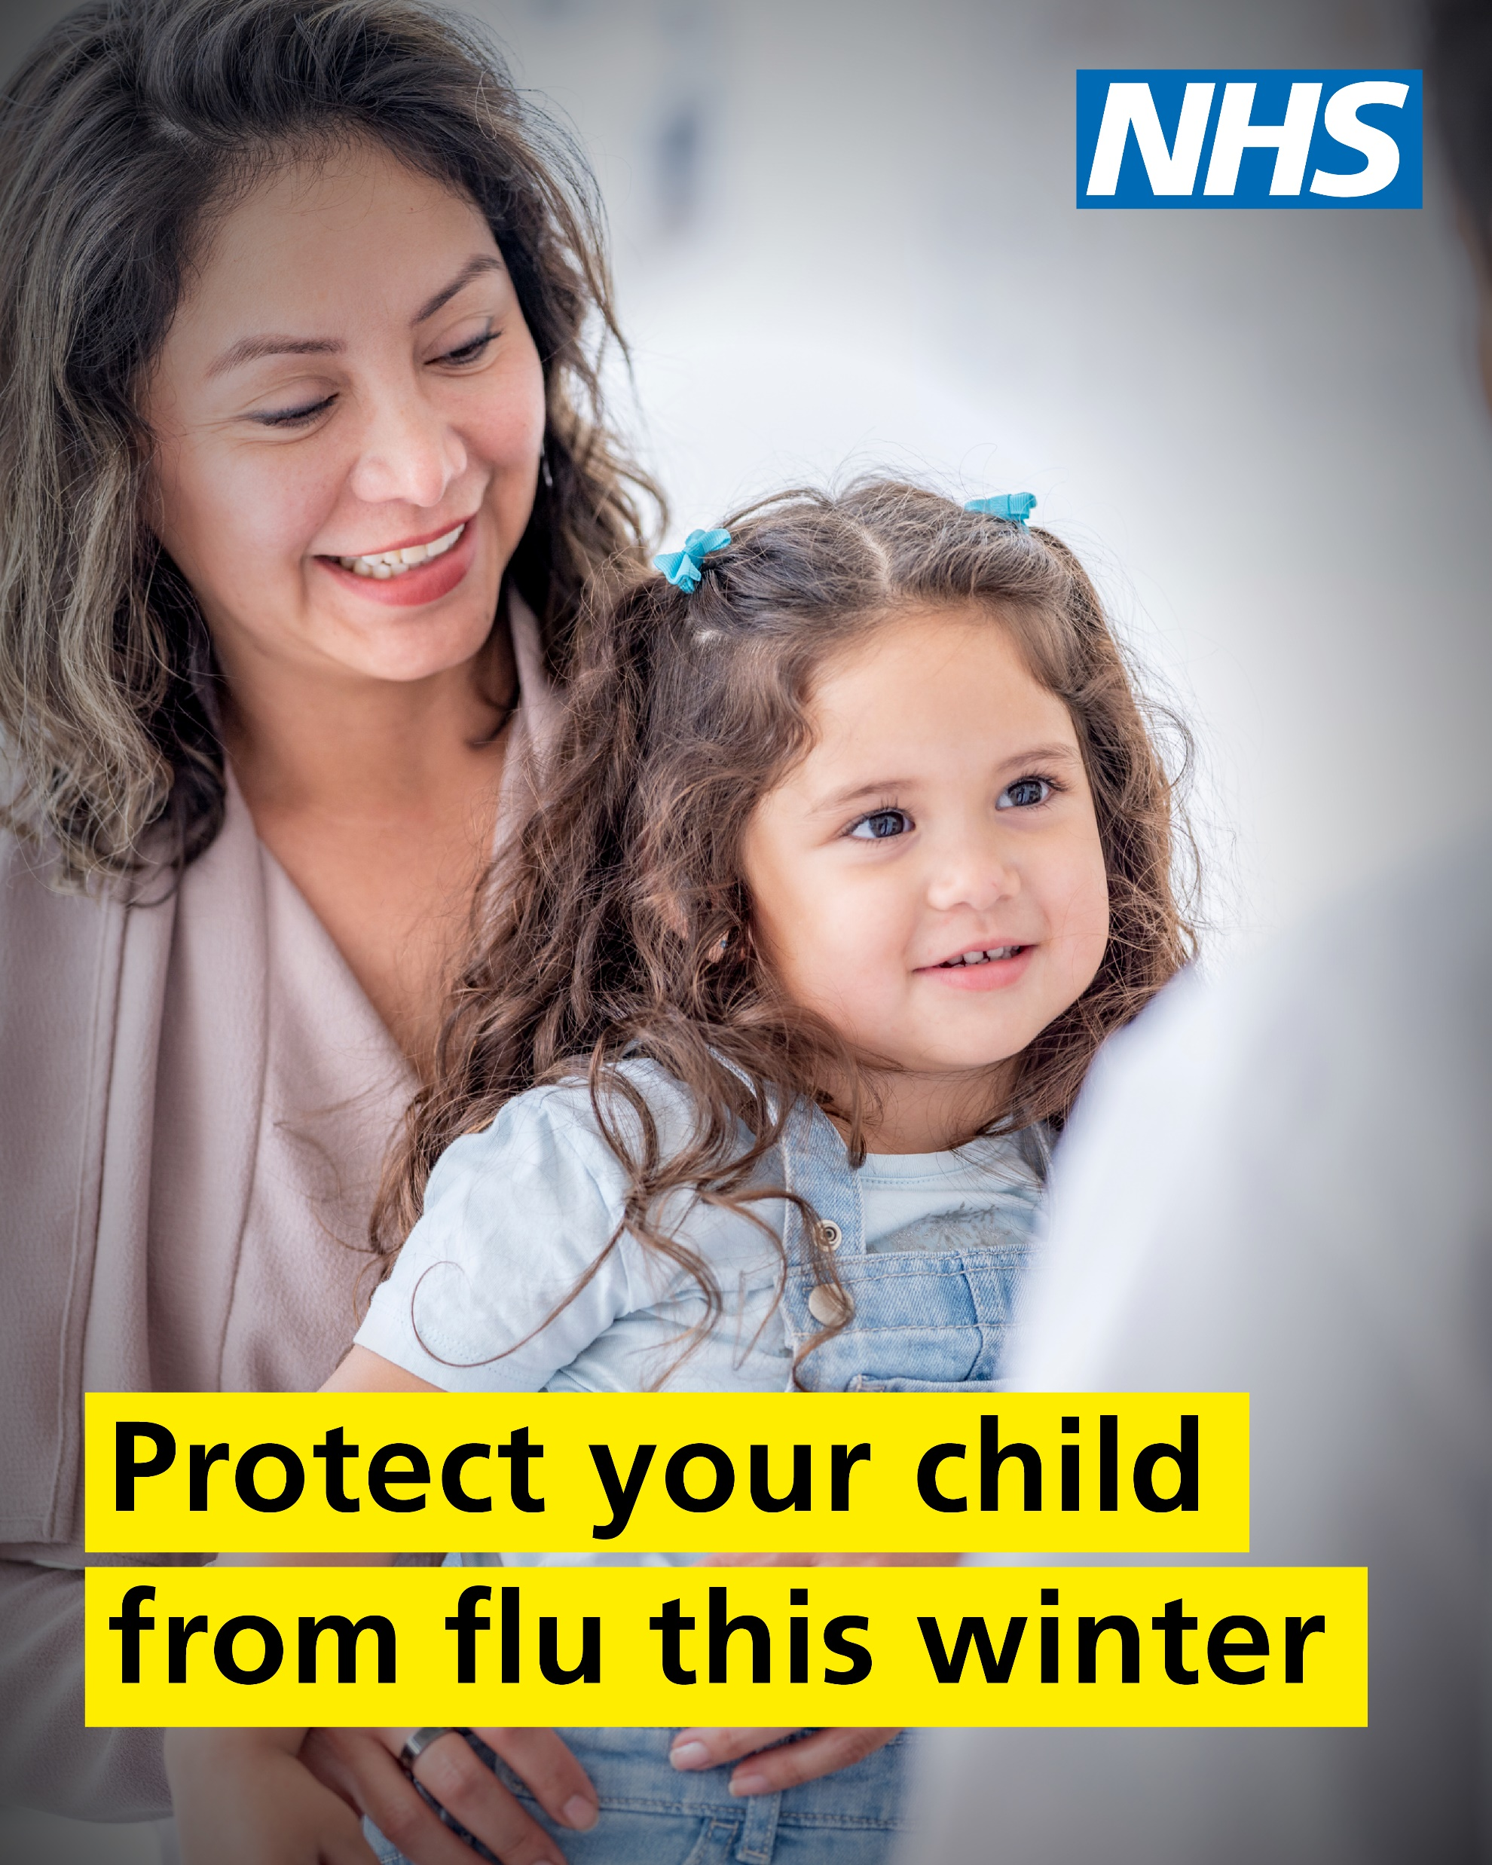
Social media images
Other flu vaccine key messages you can support. Please download and share on your channels:

Slide 19
Websites
Local information and resources about flu - Flu :: NHS Black Country ICB
Local information about the flu nasal spray - Flu nasal spray for children :: NHS Black Country ICB including a short video from Dr Tania Hussain, local GP and lead for children and young people in the Black Country, and ‘Flu Fighters’ audio books for children
Local information about flu - COVID-19 and flu :: NHS Birmingham and Solihull
Local information children’s flu vaccine - School children flu vaccinations :: NHS Birmingham and Solihull
Flu vaccine for children - local NHS resource Flu vaccine :: Black Country -18 years website
Child flu vaccine - NHS :: Vaccinations - Child flu vaccine
Vaccination tips for parents - NHS :: Vaccination tips for parents
Flu symptom and how to treat - NHS :: Condition – Flu

Slide 20
For further help or advice on using the toolkit or if you need support to tailor assets, please contact comms.blackcountry@nhs.net or communications.bsolicb@nhs.net

