Slide 1
1
30
The digraph ‘ie’ making the /ee/ sound.

Slide 2
1
The digraph ‘ie’ making the /ee/ sound.
30
Introduction | Ask the children if they know what digraph is making the /ee/ sound in the spelling list words. What ways are there to make /ee/?
Main Teaching Activity | Get the children to copy down their spelling list and then colour in the digraph in each word. Check the spellings and discuss any misconceptions or mistakes.
Independent Activity | Put the images up from the slide and see if they children know what they are and how to spell each word without the clues. You can add clues if they are finding it hard, e.g. write the first letter for them.
Spellings
chief
thief
piece
brief
handkerchief
field
belief
priest
shield
grief

Slide 3



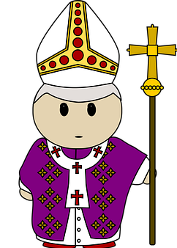

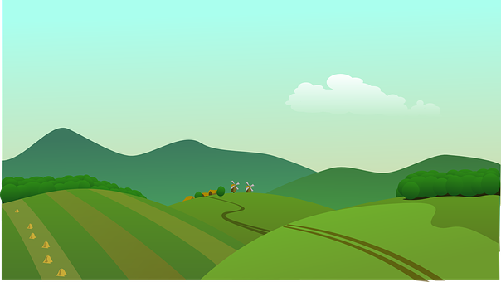
What can you see? Write down what these images are:

Slide 4
What can you see? Write down what these images are:
Answers:
handkerchief
thief
chief
priest
shield
field

Slide 5
Stage: 1 | The digraph ‘ie’ making the /ee/ sound. Name:
List: 30
Spellings | 1st Attempt | 2nd Attempt | 3rd Attempt | 4th Attempt | 5th Attempt
chief
thief
piece
brief
handkerchief
field
belief
priest
shield
grief

Slide 6
Stage: 1 | The digraph ‘ie’ making the /ee/ sound. Name:
List: 30
Roll a die or ask someone to pick a number from 1-6 for each spelling.
Spellings
chief
thief
piece
brief
handkerchief
field
belief
priest
shield
grief
Write your word in a full sentence.
Write your word in capital letters.
Write your word three times.
Write your word in different colours.
Write what your word means.
Spell the word out loud.

