Slide 1
1
5
Adding s and es to words (plurals). If the ending sounds like /s/ or /z/, it is spelled as –s. If it forms an extra syllable, then it is spelled as –es.

Slide 2
1
Adding s and es to words (plurals). If the ending sounds like /s/ or /z/, it is spelled as –s. If it forms an extra syllable, then it is spelled as –es.
5
Introduction | When adding plurals to words explain that when the plural makes an extra syllable then it is usually spelled ‘es’, for example box (one syllable) becomes boxes (2 syllables).
Main Teaching Activity | Ask the children to split the words between the two boxes, depending on whether the plural word has an extra syllable or not. Encourage children to clap the syllables in the singular word (red) and then in the plural word (green), to help them decide. Share their results and discuss.
Independent Activity | Get children to write the word ‘peaches’ across their mini white board. Set a 7 minute timer and see who can add as many of the spelling list words in to a scrabble web as possible. You can use the example on the slide below if they need some support getting started. Feedback and if time, draw a scrabble web on the board as a class.
Spellings
flowers
boxes
lunches
apples
beaches
trees
dishes
dogs
peaches
clouds

Slide 3

Say the singular word (red word) then say the plural word (green word) and see if an extra syllable has been added.
flower flowers | box boxes | lunch lunches | apple apples | beach beaches
dish dishes | dog dogs | peach peaches | cloud clouds | tree trees
Extra syllable
(es)
No extra syllable (s)

Slide 4
Say the singular word (red word) then say the plural word (green word) and see if an extra syllable has been added.
Answers:
flower flowers | box boxes | lunch lunches | apple apples | beach beaches
dish dishes | dog dogs | peach peaches | cloud clouds | tree trees
box
boxes
cloud
clouds
tree
trees
lunch
lunches
apple
apples
dog
dogs
peach
peaches
flower
flowers
beach
beaches
dish
dishes
Extra syllable
(es)
No extra syllable (s)

Slide 5
t
r
flowers
u
n
c
h
es
beac

Slide 6
Answers (e.g.):
P
aches
dog
ishes
t
r
louds
flowers
es
u
n
c
hes
Beac es
oxes
pples

Slide 7
Stage: 1 | Adding s and es to words (plurals). If the ending sounds like /s/ or /z/, it is spelled as –s. If it forms an extra syllable, then it is spelled as –es. Name:
List: 5
Spellings | 1st Attempt | 2nd Attempt | 3rd Attempt | 4th Attempt | 5th Attempt
flowers
boxes
lunches
apples
beaches
trees
dishes
dogs
peaches
clouds

Slide 8


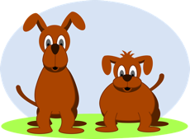
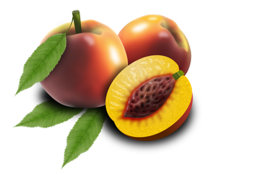




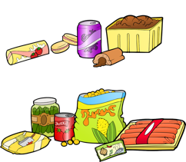
Stage: 1 | Adding s and es to words (plurals). If the ending sounds like /s/ or /z/, it is spelled as –s. If it forms an extra syllable, then it is spelled as –es. Name:
List: 5
Spellings
flowers
boxes
lunches
apples
beaches
trees
dishes
dogs
peaches
clouds

Slide 9
Stage: 1 | Adding s and es to words (plurals). If the ending sounds like /s/ or /z/, it is spelled as –s. If it forms an extra syllable, then it is spelled as –es. Answers:
List: 5
Spellings
flowers
boxes
lunches
apples
beaches
trees
dishes
dogs
peaches
clouds
clouds | beaches | dogs | peaches | dishes
boxes | flowers | apples | lunches | trees

