Slide 1
Monday 12th July 2021
Enterprise week
WALT: identify features of a text.

Slide 2
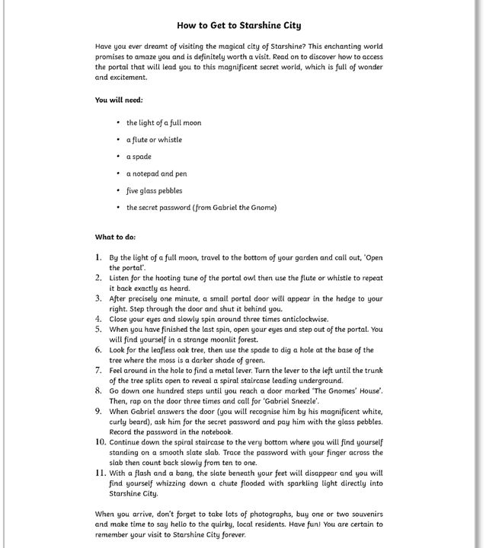
Read the text . . . . .
What genre do you think it is?
When would you use a text like this?

Slide 3

Instructions
Instructions tell us how do to something.
There are many different types of instructions. Some examples include:
recipes;
directions;
how to play a game;
how to make or build something;
how to repair something;
or how to look after/care for something.
Can you think of any more examples?

Slide 4
Features of instructions . . .
Title | Tell the reader what is to be done in and select vocabulary to engage the reader. Add a question
What you will need | List what will be needed to carry out the task. Consider using: Numbering (1,2 …) Alphabetical ordering (a, b, c ….) Bullet points Don’t forget to start a new line for each new item.
Method | Tell the reader how to make/play/do it. Use clear subheadings List the steps in order. Use adverbs of manner and adjectives to describe (gently, bright). Develop the imperative voice. Emphasise key words Include an annotated diagram and pay careful attention to layout and clarity.
Concluding paragraph | Tell the reader how they will know they have been successful. If something went wrong (perhaps a common error) how could they fix it?

Slide 5

Layout devices will also be used to structure and organise the text. These may include headings and subheadings, underlining, bold or italic text, bullet points and numbers.

Slide 6
Take a look at the text, which features can you find?

