Slide 1
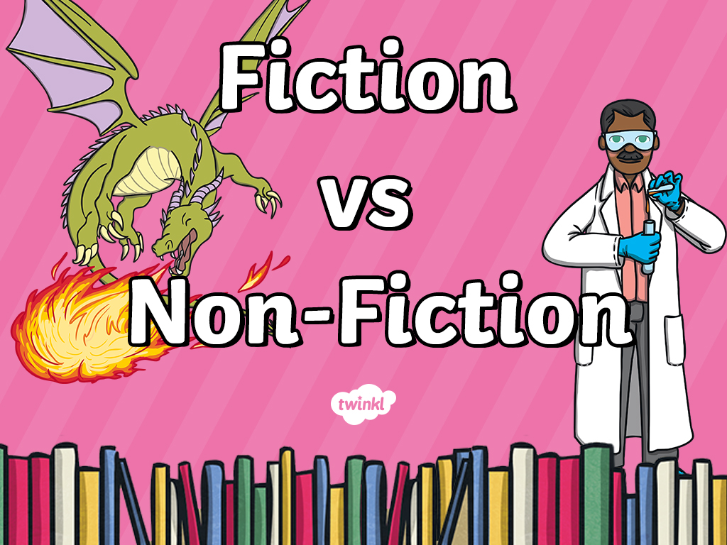

Slide 2

Fiction vs Non-Fiction
What’s the Difference?
Fiction Books
contain made up stories.
Non-Fiction Books contain true facts
and information.

Slide 3
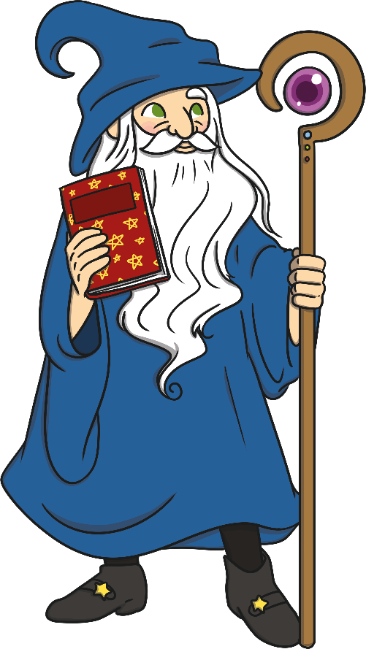
Features of a Fiction Book
“Fiction” books are filled with made up stories, created from the imagination of the author. They are not real and sometimes they even include talking animals! Fiction books will usually include these features:
Not real
Tells a story
Characters and setting
Illustrations
Problem and solution
Should be read in order

Slide 4
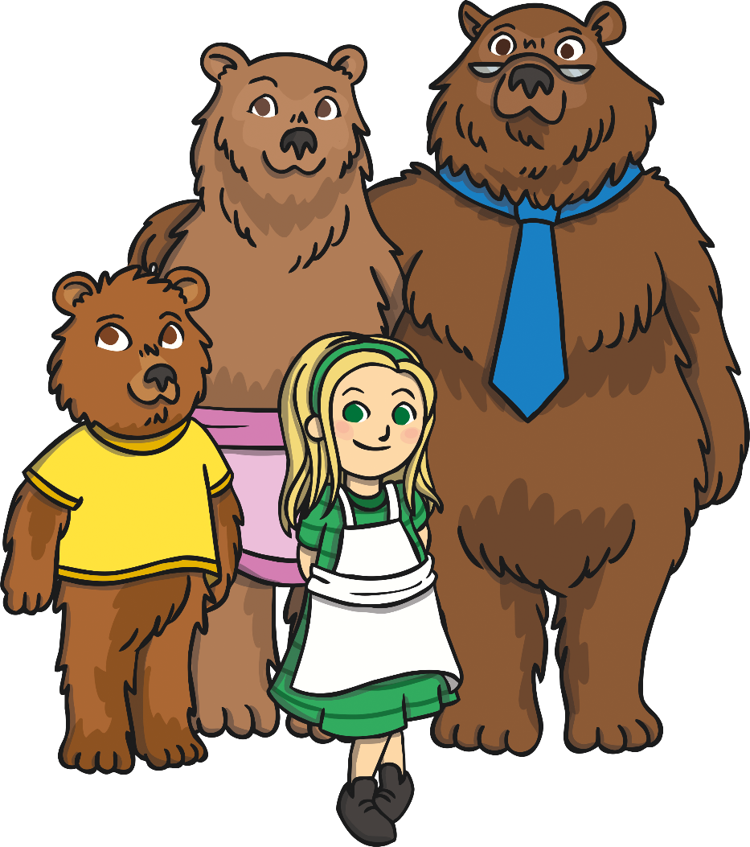
Examples of Fiction
There are many different kinds of fiction books and texts. These are just some of the different examples:
Fairy Tales and Nursery Rhymes
Picture Story Books
Chapter Books
Novels

Slide 5
Can You Think of Any Other Types of Fiction Texts?
Remember, it doesn’t have to be a book! Twist and turn to the person next to you to discuss.
?
?
?
?

Slide 6

Features of a Non-Fiction Book
“Non-fiction” books are based in fact, they give the reader information and help us to learn more about different things. Non-fiction books will usually contain these features:
Fun Fact:
Did you know that non-fiction books do not need to be read in order?
Real facts
Gives information
Contents page
Glossary
Index
Headings and sub-headings
Diagrams with labels
Photographs

Slide 7


Examples of Non-Fiction
There are so many different kinds of non-fiction books and texts. These are just some of the different examples:
Fun Fact:
Non-Fiction isn’t just for books either. Documentaries are another good example of Non-Fiction.
Dictionary
History Books
Animal Nature Books
General Knowledge and Trivia
Science Books
Travel Books
Art Books
Biographies and Autobiographies

Slide 8
Can You Think of Any Other Types of Non-Fiction Texts?'
Remember, it doesn’t have to be a book! Twist and turn to the person next to you to discuss.
?
?
?
?

