Slide 2
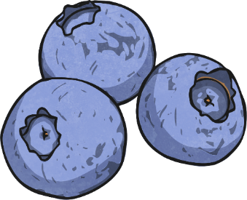
What Am I?
Click the numbers to reveal a clue. When you have guessed the fruit or vegetable, click the reveal answer button.
1
I am small.
2
I taste sweet.
3
I am blue.
I am blueberries!
Reveal Answer

Slide 3
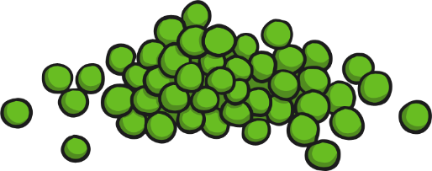
What Am I?
Click the numbers to reveal a clue. When you have guessed the fruit or vegetable, click the reveal answer button.
1
We grow in a pod.
2
We are small and round.
3
We are green.
We are peas!
Reveal Answer

Slide 4
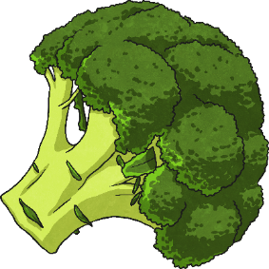
What Am I?
Click the numbers to reveal a clue. When you have guessed the fruit or vegetable, click the reveal answer button.
1
I am green.
2
I am cooked to eat.
3
I look like a little tree.
I am broccoli!
Reveal Answer

Slide 5
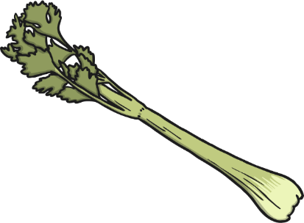
What Am I?
Click the numbers to reveal a clue. When you have guessed the fruit or vegetable, click the reveal answer button.
1
I come in stalks.
2
I am green and long.
3
I am crunchy.
I am celery!
Reveal Answer

Slide 6
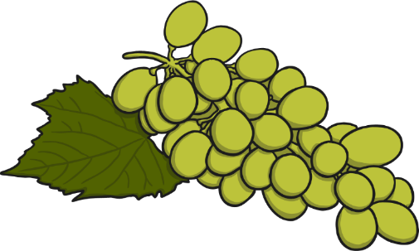
What Am I?
Click the numbers to reveal a clue. When you have guessed the fruit or vegetable, click the reveal answer button.
1
We grow in bunches.
2
We can be red or green.
3
We are small and sweet.
We are grapes!
Reveal Answer

Slide 7
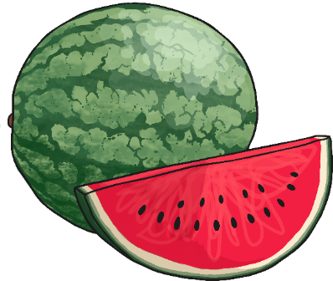
What Am I?
Click the numbers to reveal a clue. When you have guessed the fruit or vegetable, click the reveal answer button.
1
I am large.
2
I am green on the outside.
3
I am pink on the inside.
I am a watermelon!
Reveal Answer

Slide 8
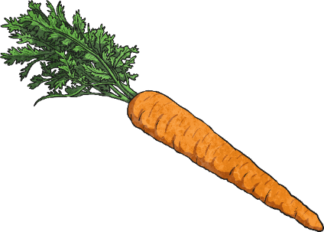
What Am I?
Click the numbers to reveal a clue. When you have guessed the fruit or vegetable, click the reveal answer button.
1
I grow in the ground.
2
I am crunchy if eaten raw.
3
I am orange.
I am a carrot!
Reveal Answer

Slide 9
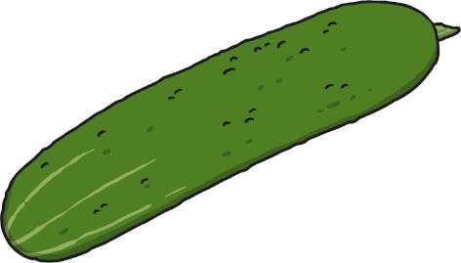
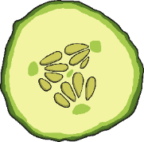
What Am I?
Click the numbers to reveal a clue. When you have guessed the fruit or vegetable, click the reveal answer button.
1
I am used in salads.
2
I am crunchy.
3
I am long and have green skin.
I am a cucumber!
Reveal Answer

Slide 10
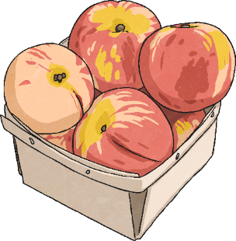
What Am I?
Click the numbers to reveal a clue. When you have guessed the fruit or vegetable, click the reveal answer button.
1
I grow on a tree.
2
I have a stone inside me.
3
I have fuzzy skin.
4
I taste sweet.
I am a peach!
Reveal Answer

Slide 11
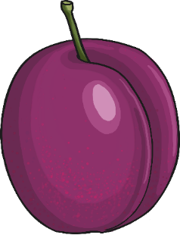
What Am I?
Click the numbers to reveal a clue. When you have guessed the fruit or vegetable, click the reveal answer button.
1
I grow on a tree.
2
I have purple or red skin.
3
I have a stone inside me.
4
I am soft to eat.
I am a plum!
Reveal Answer

Slide 12
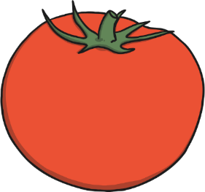
What Am I?
Click the numbers to reveal a clue. When you have guessed the fruit or vegetable, click the reveal answer button.
1
I am round and red.
2
I have seeds inside me.
3
I can be cooked or eaten raw.
4
I am soft to eat.
I am a tomato!
Reveal Answer

Slide 13

What Am I?
Click the numbers to reveal a clue. When you have guessed the fruit or vegetable, click the reveal answer button.
1
I am round.
2
I am red or green.
3
‘Granny Smith’ is a common variety of me.
I am an apple!
Reveal Answer

Slide 14

What Am I?
Click the numbers to reveal a clue. When you have guessed the fruit or vegetable, click the reveal answer button.
1
I am bitter.
2
I am yellow.
3
I have a rind.
I am a lemon!
Reveal Answer

Slide 15
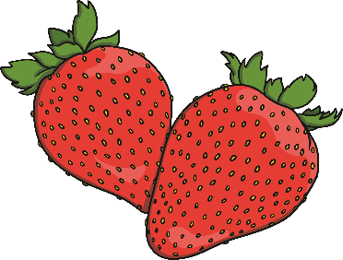
What Am I?
Click the numbers to reveal a clue. When you have guessed the fruit or vegetable, click the reveal answer button.
1
I am sweet.
2
I am red.
3
I am used in jam.
I am a strawberry!
Reveal Answer

Slide 16
What Am I?
Click the numbers to reveal a clue. When you have guessed the fruit or vegetable, click the reveal answer button.
1
I am round.
2
I have a peel.
3
I can be made into juice.
I am an orange!
Reveal Answer

Slide 17
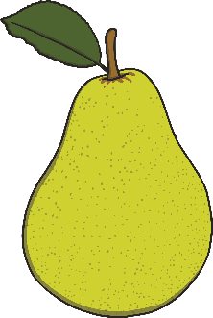
What Am I?
Click the numbers to reveal a clue. When you have guessed the fruit or vegetable, click the reveal answer button.
1
I am sweet.
2
I fit in your hand.
3
I can be eaten raw or baked.
I am a pear!
Reveal Answer

Slide 18
What Am I?
Click the numbers to reveal a clue. When you have guessed the fruit or vegetable, click the reveal answer button.
1
I am small.
2
I am round.
3
I am tart.
I am a black currant!
Reveal Answer

Slide 19
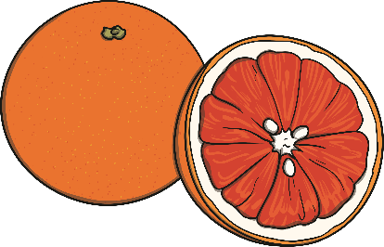
What Am I?
Click the numbers to reveal a clue. When you have guessed the fruit or vegetable, click the reveal answer button.
1
I am sour.
2
I am pink inside.
3
I am round.
I am a grapefruit!
Reveal Answer

Slide 20
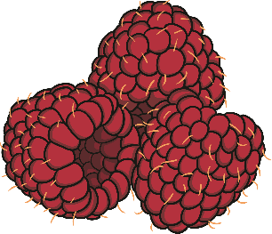
What Am I?
Click the numbers to reveal a clue. When you have guessed the fruit or vegetable, click the reveal answer button.
1
I am small.
2
I am a berry.
3
I am red or purple.
I am a raspberry!
Reveal Answer

Slide 21
What Am I?
Click the numbers to reveal a clue. When you have guessed the fruit or vegetable, click the reveal answer button.
1
I am sour.
2
I am green.
3
I have a rind.
I am a lime!
Reveal Answer

Slide 22
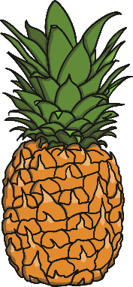
What Am I?
Click the numbers to reveal a clue. When you have guessed the fruit or vegetable, click the reveal answer button.
1
I am sweet.
2
I have a spikey top.
3
I am canned in rings.
I am a pineapple!
Reveal Answer

Slide 23
What Am I?
Click the numbers to reveal a clue. When you have guessed the fruit or vegetable, click the reveal answer button.
1
I am small.
2
I am a berry.
3
I am black.
I am a blackberry!
Reveal Answer

Slide 24
What Am I?
Click the numbers to reveal a clue. When you have guessed the fruit or vegetable, click the reveal answer button.
1
I grow in the ground.
2
I can be white or red.
3
I might have eyes!
I am a potato!
Reveal Answer

Slide 25
What Am I?
Click the numbers to reveal a clue. When you have guessed the fruit or vegetable, click the reveal answer button.
1
I am white.
2
I have green leaves.
3
I look like a little tree.
I am a cauliflower!
Reveal Answer

Slide 26
What Am I?
Click the numbers to reveal a clue. When you have guessed the fruit or vegetable, click the reveal answer button.
1
I grow in trees.
2
I have yellow skin.
3
I am white inside.
I am a banana!
Reveal Answer

