Slide 1
Bullying
Anti-Bullying DAY Thursday 4th April 2023

Slide 2

What is bullying?
Bullying is the repetitive, intentional hurting of one person or group by another person or group, where the relationship involves an imbalance of power. It can happen face to face or online.

Slide 3
What Bullying is not!
Incidents that are one off.
A person saying unkind comments once.
One person bumping into you on the playground once.
Some looking at you.
A person talking abut you to a friend once.
IT IS, REPETITIVE, INTENTIONAL HURTING

Slide 4
S.T.O.P
To help us remember the definition of bullying we can use the acronym stop.
SEVERAL
TIMES
ON
PURPOSE

Slide 5
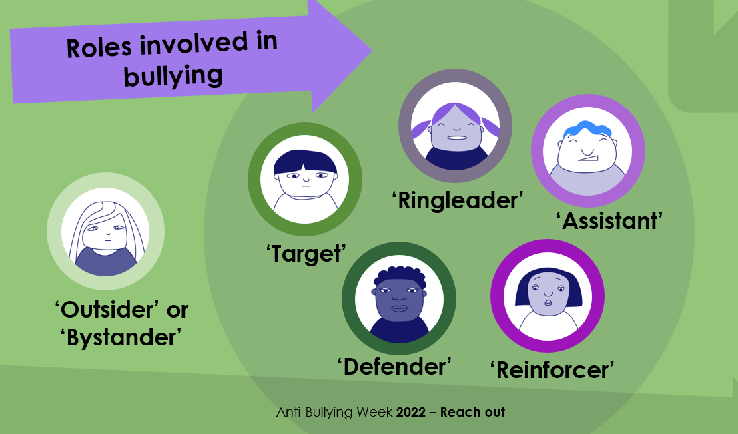

Slide 6
The Target
There is the target and this is the person the bullying is aimed at!

Slide 7
Ringleader
There is the ringleader and this is the person who is initiating or leading the bullying. They might even be telling other people to join in.

Slide 8
The Reinforcer
The reinforcer is someone who doesn’t ‘do’ any bullying themselves but supports the bullying behaviour by standing by the ringleader and assistants, laughing along and encouraging the behaviour to continue.

Slide 9
The Assistant
The assistant is some who is involved in ‘doing’ the bullying behaviour led by the ringleader, and might be actively doing the name calling or whatever the bullying might be.

Slide 10
The Outsider
You also have the outsider or bystander role. This is someone who is either unaware of the bullying happening, or is choosing to ignore it and not involve themselves at all.

Slide 11
The Defender
There is also the defender, and that doesn’t always mean actively standing up to the ones doing the bullying – it could also mean telling a trusted adult what they have seen or even just asking the target if they are ok.

Slide 12

What to do if you see bulling

Slide 13
Scenario 1
Every time Bobby goes onto the field at break time, a group of girls follow him around and are unkind to him. Two of the girls shout names, and the rest of them watch and laugh along.
Which roles can you spot?
How could they reach out?

Slide 14
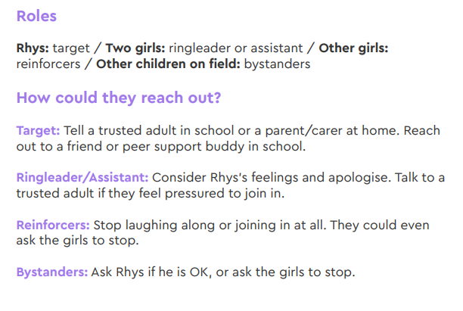
Scenario 1

Slide 15
Scenario 2
Vanisha has noticed that every time her class line up for lunch, there are some children who are pushing Erin around.
Which roles can you spot?
How could they reach out?

Slide 16
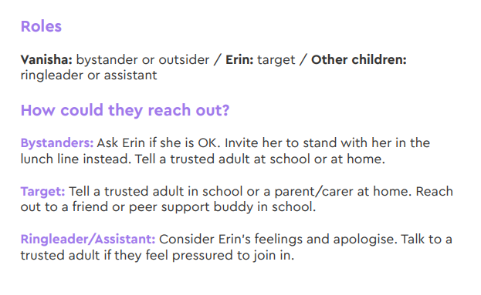
Scenario 2

Slide 17
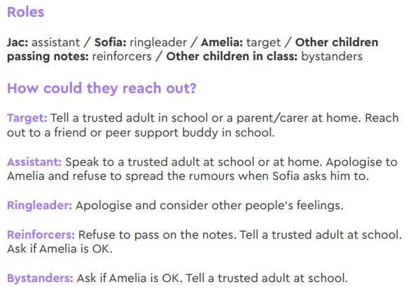
Scenario 3

Slide 18
Scenario 3
Jac is often told by Sofia to spread unkind rumours about Amelia by whispering and passing notes around.
Which roles can you spot?
How could they reach out?

Slide 19
Are we a reach out school?
How can we show everyone that our school does not tolerate bullying?
Using the acronym STOP and create a poster highlighting what bullying is.
Poster about how to reach out to friends, family and/or teachers.
Poems and message on our website
What else could we do?

